Slide 1
Web Phishing Detection using Machine Learning
Presented by
Ansh Sharma (22070127011)
Priyanshu Lathi (22070127048)

Slide 2

Introduction
Contributions
Literature
Index
Research Gap
Results
Problem Statement
Methodology
Objective

Slide 3
Introduction
Web phishing is a fraudulent tactic where cybercriminals impersonate legitimate organizations to deceive individuals into sharing sensitive information like passwords or credit card details. They typically use fake emails or websites that closely resemble the real ones. The aim is to trick users into divulging personal data, which can be used for identity theft or financial fraud. Phishing attacks can also occur through text messages or phone calls. Protecting against phishing involves being cautious with electronic communications, verifying the authenticity of websites and requests, and employing security measures like email filtering and multi-factor authentication to mitigate risks.

Slide 4
Literature Survey
Research Papers | Methodology | Feature extraction technique | Model/ algorithm | Accuracy
Phishing Website Detection Using Machine Learning: A Review By - Dr. Nahla Abbas Flayh And Marwa Abd Al Hussein Qasim | Feature extraction, using different models to train and detecting malicious websites in real time |  | Decision tree, Random Forest and Support vector machine | 93%,97%,96%
Detecting Phishing Websites Using Machine Learning By- Aniket Garje1 , Namrata Tanwani1 , Sammed Kandale1 , Twinkle Zope1 , Prof. Sandeep Gore2 | Feature extraction,model training,cross validation and detecting malicious websites in real time |  | Decision Tree,KNN, Naïve byes, | 99%,97%,96%

Slide 5
Research Papers | Methodology | Feature extraction technique | Model/ algorithm | Accuracy
Phishing Website Detection using Machine Learning Algorithm | Feature Extraction,splilting the data, training and validation |  | Decision Tree, Random Forest, Support vector machine | 97.14%

Slide 6
Research Gap:
Get better accuracy than existing models
Reduce computational time
Detecting malicious websites in real time

Slide 7
Problem Statement
Develop a machine learning-based solution for detecting web phishing attempts in real-time. The objective is to create a robust system capable of accurately identifying fraudulent websites that impersonate legitimate entities to steal sensitive information from users. The solution should leverage features such as website content, URL characteristics, and server information to train and deploy a model capable of distinguishing between genuine and phishing websites. The system should be scalable, efficient, and able to adapt to emerging phishing tactics. Evaluation metrics should include accuracy, precision, recall, and F1-score, with a focus on minimizing false positives to enhance user trust and security.

Slide 8
Objective:
Identify and classify fraudulent websites accurately: Train a model to differentiate between legitimate and phishing websites by analyzing various features such as website content, URL characteristics, and server information.
Ensure real-time detection: Implement a solution capable of quickly analyzing web pages as users access them, enabling prompt detection and prevention of phishing attempts..
Enhance security and user trust: Minimize false positives and false negatives to improve the system's reliability and user confidence in detecting phishing attacks.

Slide 9
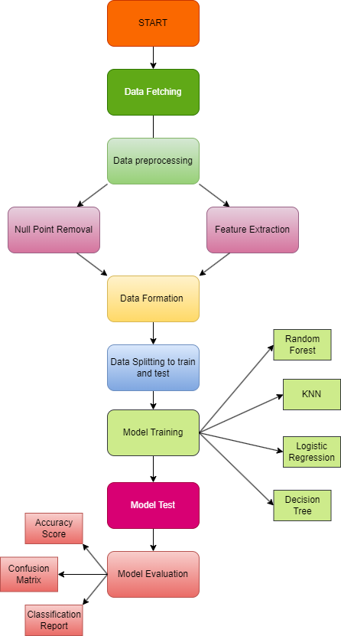
Methodology and Method

Slide 10
Results and discussion
Following results were recorded after model evaluation:
Model | Accuracy
Random Forest | 95%
KNN | 94%
Logistic Regression | 92%
Decision Tree | 95%

Slide 11
Conclusion
In conclusion, this project has demonstrated the effectiveness of machine learning algorithms in detecting web phishing attempts using a comprehensive dataset of URL and webpage attributes. The high accuracies achieved by K-Nearest Neighbors, Logistic Regression, and Random Forest models emphasize the potential of these techniques in bolstering cybersecurity measures against phishing attacks.
The study underscores the importance of feature selection and dataset quality in training robust phishing detection models. By leveraging diverse features such as URL structure, webpage content, and domain characteristics, the models were able to discern subtle indicators of phishing attempts with notable accuracy.
Moving forward, further advancements in machine learning techniques, coupled with continuous updates to datasets reflecting evolving phishing tactics, are essential to stay ahead of cyber threats. Additionally, the integration of real-time monitoring and adaptive learning mechanisms could enhance the agility and responsiveness of phishing detection systems.
Overall, this research contributes to the ongoing efforts in cybersecurity by providing insights into the efficacy of machine learning in combating web-based phishing attacks. By leveraging the power of data-driven approaches, organizations can fortify their defences and mitigate the risks posed by malicious actors in the digital landscape.

